Slide 1

PREDICTION OF STOCK MARKET DATA AND BUILDING A STRATEGY TO FIND RETURN ON INVESTMENT USING DEEP LEARNING METHODS
- JAGANNATH E
Guided by
Mr. SANJEEV KUMAR JHA Joint Director (Tech.)
NATIONAL INSTITUTE OF ELECTRONICS AND INFORMATION TECHNOLOGY [NIELIT] CHENNAI

Slide 2

INTRODUCTION

Slide 3
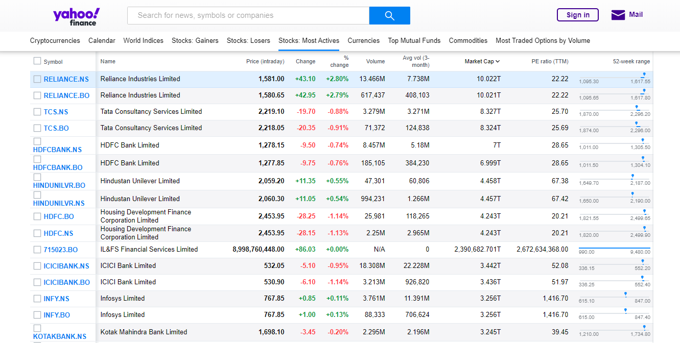
Source of my data

Slide 4
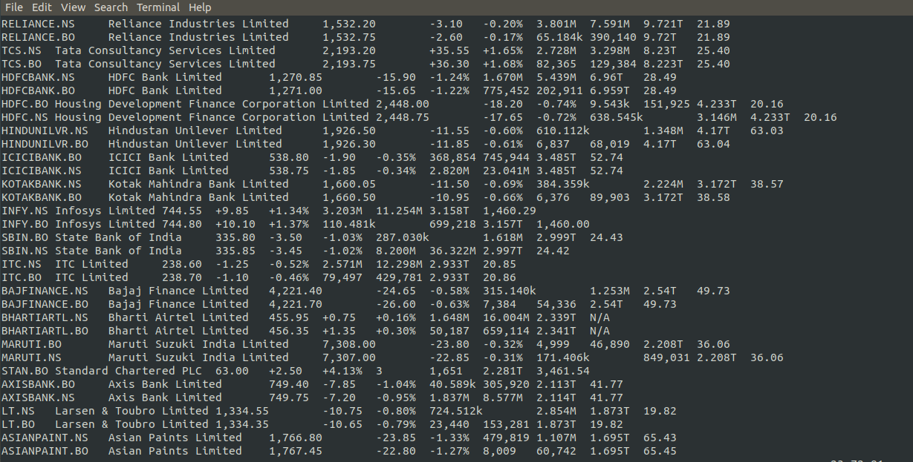
Importing RAW information into my Linux System

Slide 5
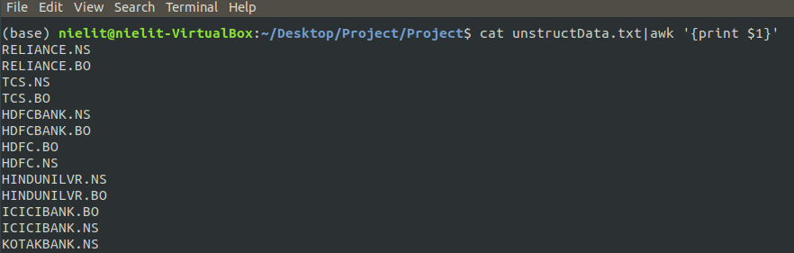
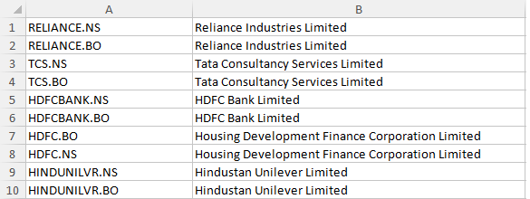
Collecting the field tickers using ShellScript
Top 10 Stocks in Indian Stock Exchange

Slide 6
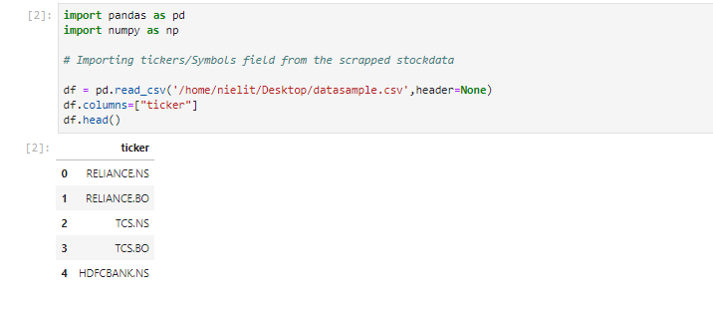
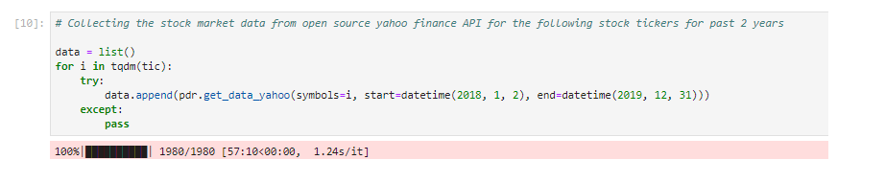
Data Acquisition

Slide 7
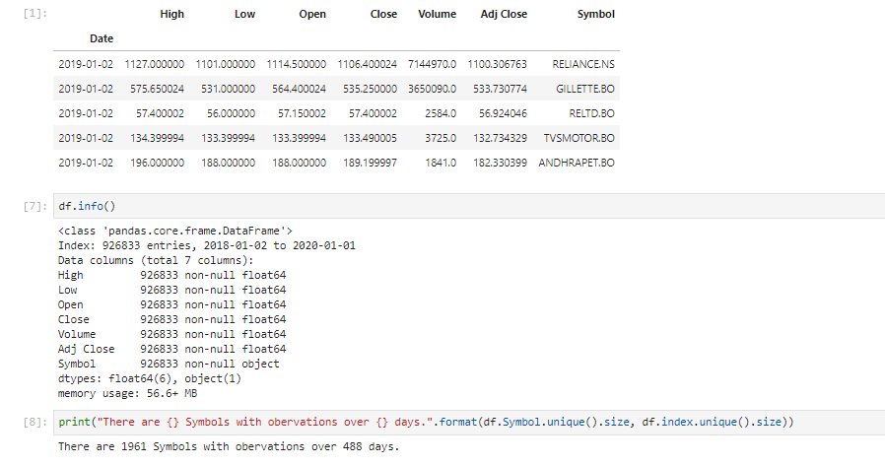

Slide 8
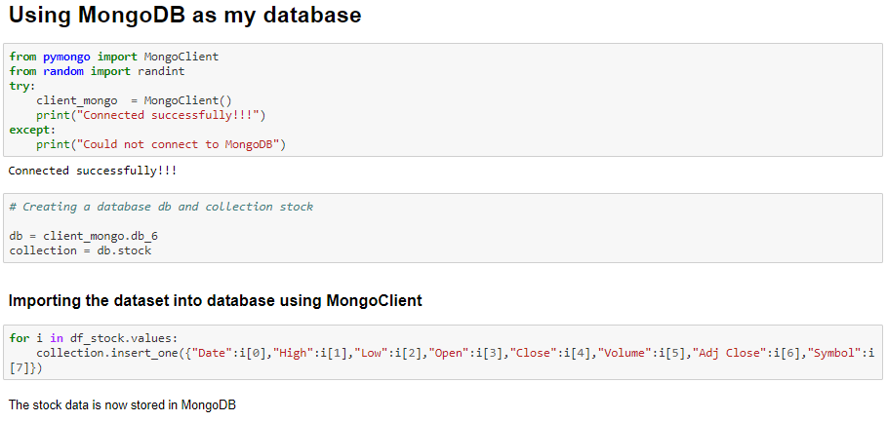
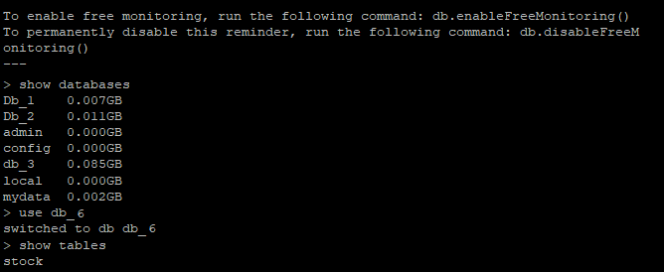

Slide 9
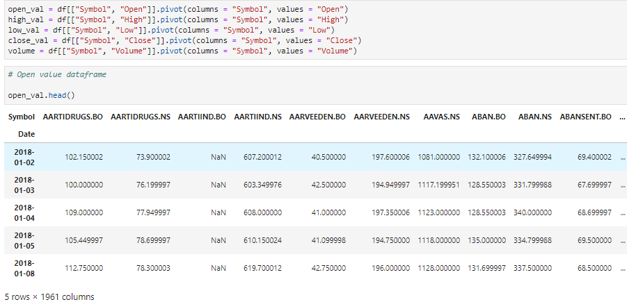
Data Pre-Processing
next_val = (close_val.shift(-1) / close_val - 1)
ret_val = (close_val / close_val.shift(1)) - 1)
hl_val = high_val / low_val

Slide 10
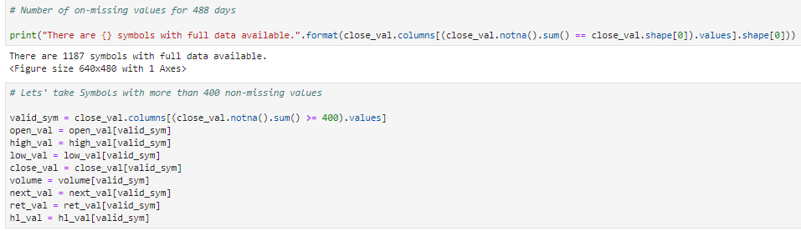
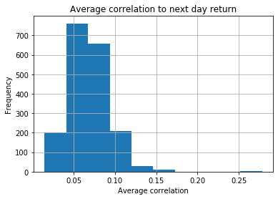

Slide 11
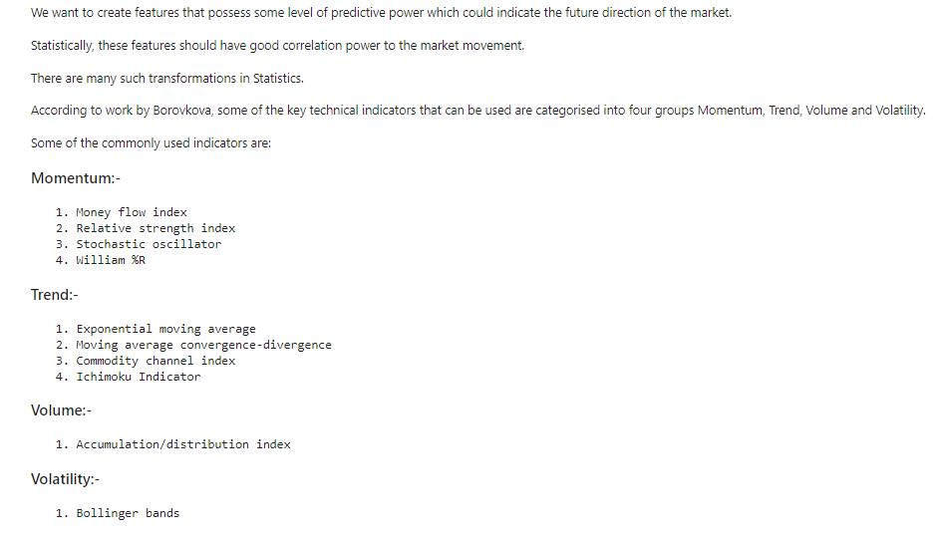
Technical Analysis

Slide 12
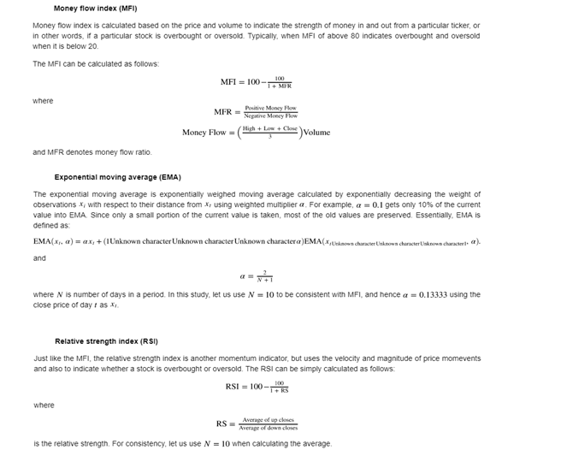
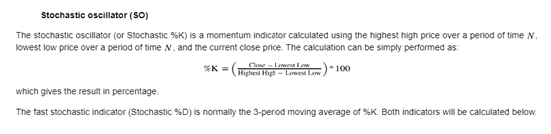

Slide 13
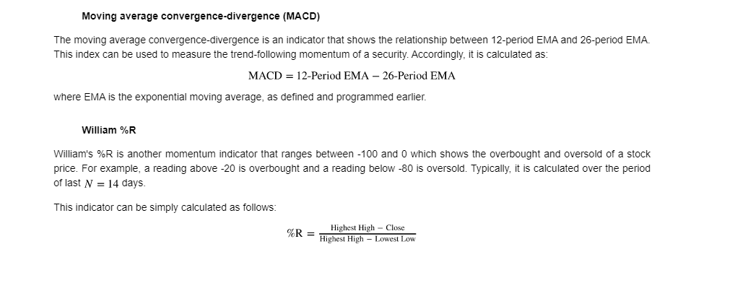
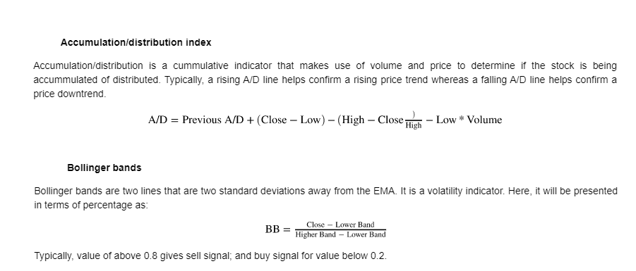
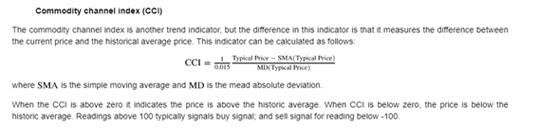

Slide 14
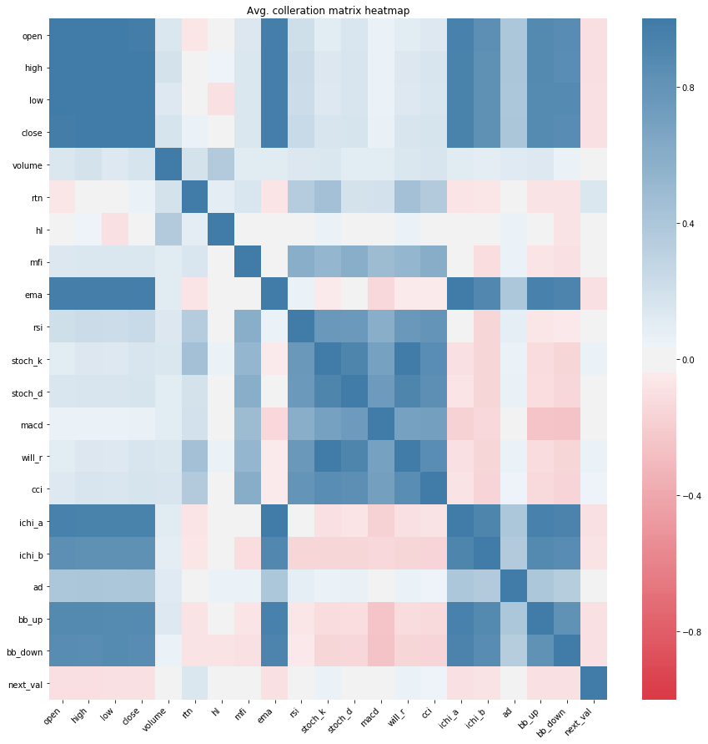

Slide 15
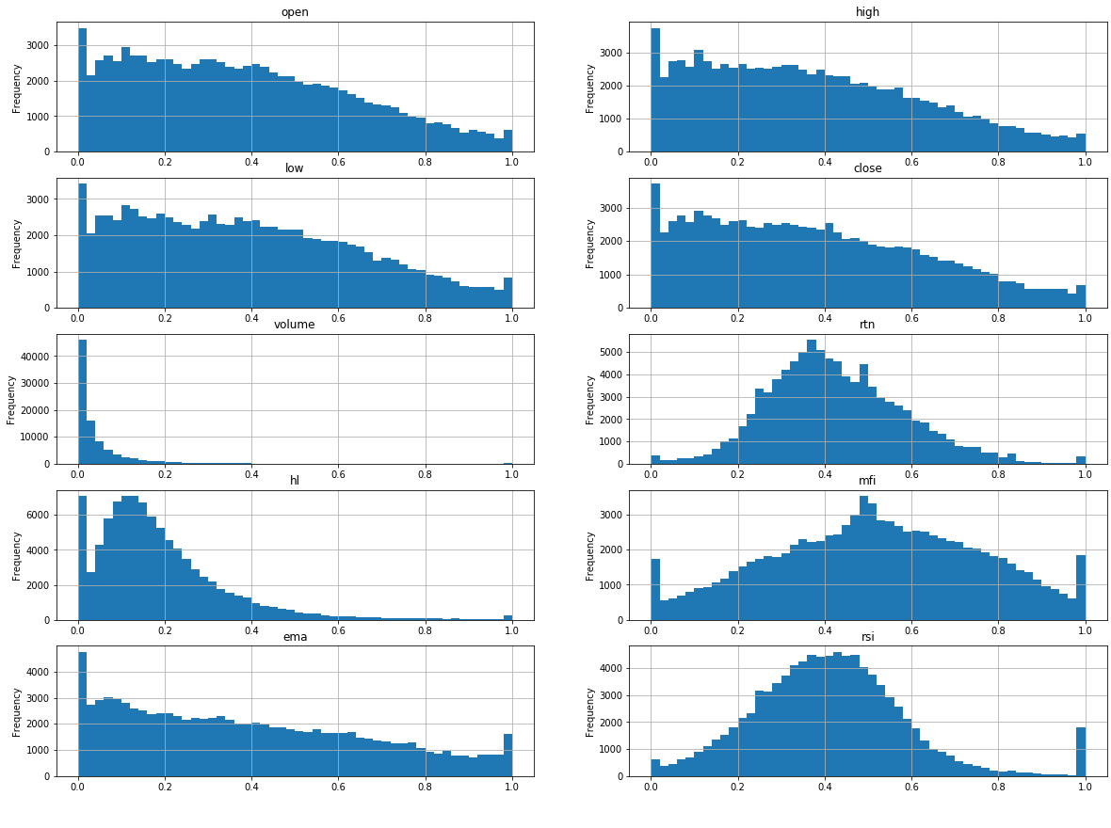

Slide 16
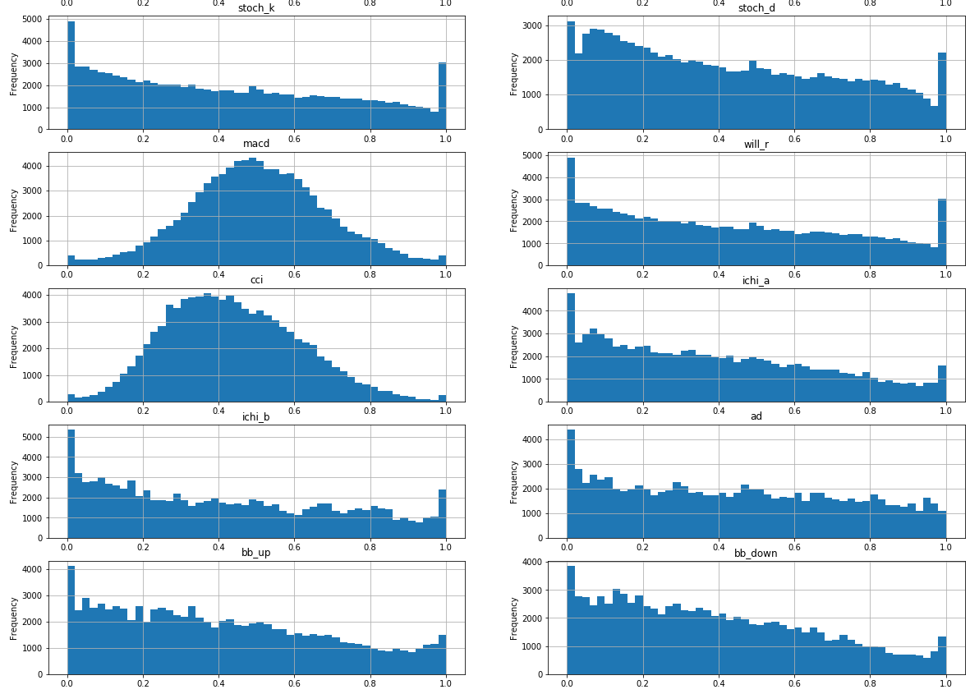

Slide 17
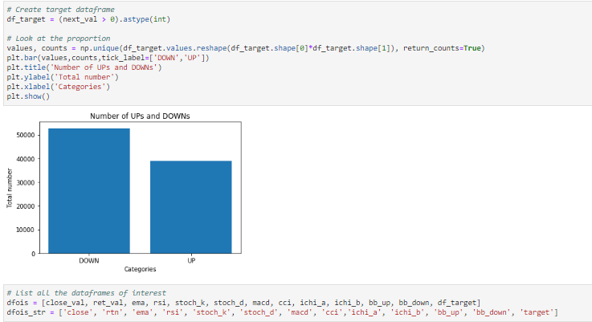
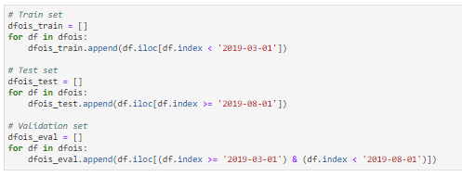
Train: 2018–01–02 to 2019-03-01
Validation: 2019–03–02 to 2019–07–31
Test: 2019–08-–01 to 2020–01–01

Slide 18
Normalizing and Scaling the data
Let us normalise all the data to be between 0 and 1. Note that the maximum and minimum is with respect to each ticker in each train data frame
Let us scale the data to have mean 0 and unit variance. This scaling is done by training the scaler using data of entire normalised training data frame. This will be used to transform the training, validation, and test sets.
Sequencing the data
60 Time Steps
Let's sequence the data. We are going to use the past 60 days of data for the next day prediction, we need to append the past 60 days worth data and append them in an array. We first write a function and execute onto all three sets of data.

Slide 19
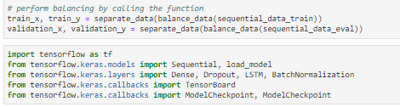
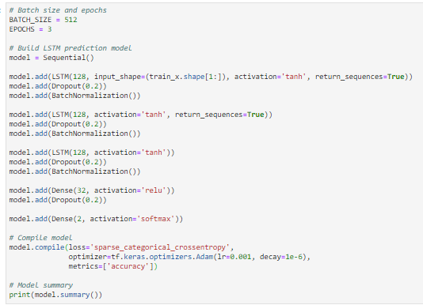
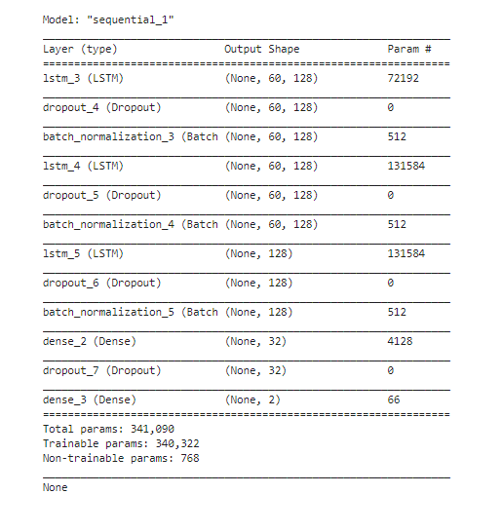
Building a Long-Short Term Memory Model
Training data length: 42864 Validation data length: 7896 Testing data length: 7708

Slide 20
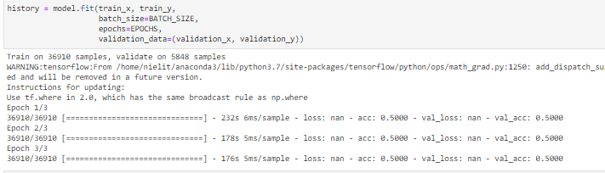
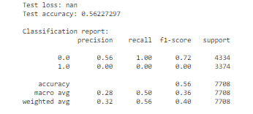
Let us define a simple trading strategy. Of all 188 tickers used, open position using $1 for each ticker based on the predicted movement by the LSTM network, and close position the next day. This means that every day, an investment of $188 is made and position must be closed the next day

Slide 21
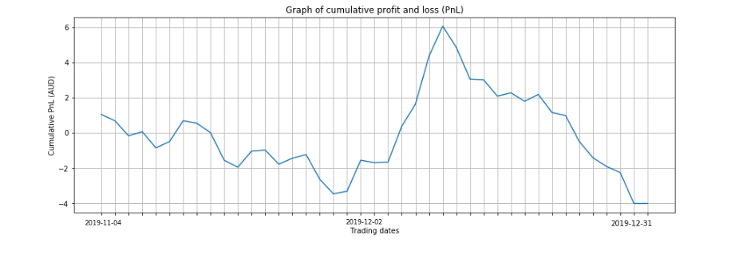
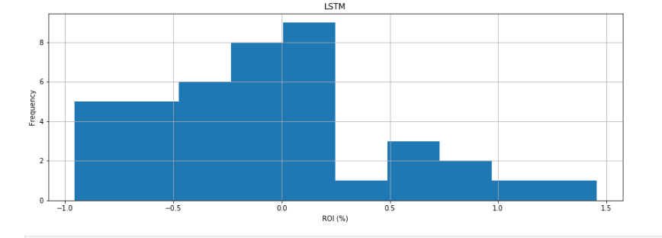
Trading Strategy

Slide 22
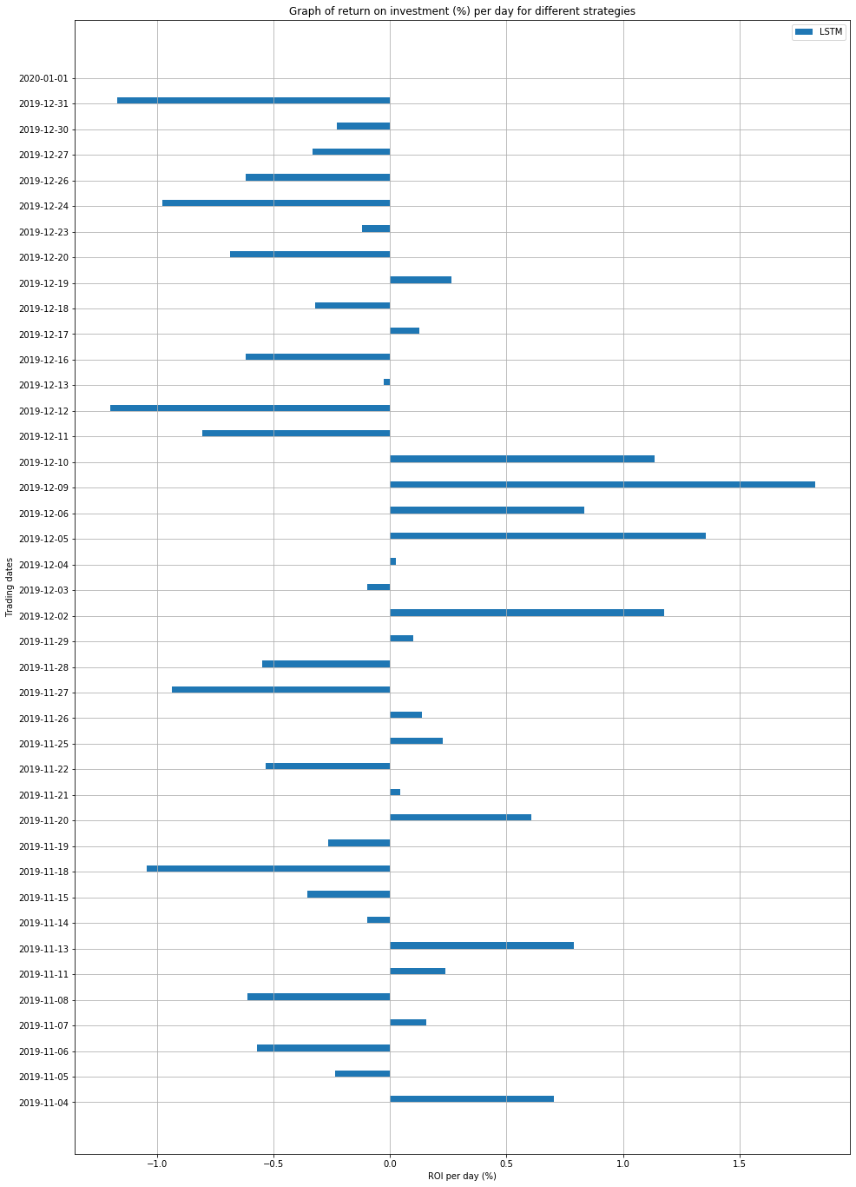

Slide 23

Conclusion

Slide 24
REFERENCES
[1] Borovkova S, Tsiamas I. An ensemble of LSTM neural networks for high-frequency stock market classification. Journal of Forecasting. 2019;1–20. https://doi.org/10.1002/for.2585
[2] Zhai Y, Hsu A, Halgamuge SK. Combining News and Technical Indicators in Daily Stock Price Trends Prediction. Lecture Notes in Computer Science. 2007; https://link.springer.com/chapter/10.1007/978-3-540-72395-0_132
[3] Hegazy O, Soliman OS, Salam MA. A Machine Learning Model for Stock Market Prediction. International Journal of Computer Science and Telecommunications. 2013; 17–23. https://www.ijcst.org/Volume4/Issue12/p4_4_12.pdf
[4] Vargas MR, dos-Anjos CEM, Bichara GLG, Evsukoff AG. Deep Learning for Stock Market Prediction Using Technical Indicators and Financial News Articles. 2018; https://doi.org/10.1109/IJCNN.2018.8489208
[5] Padial DL. Technical Analysis Library in Python. 2019; https://github.com/bukosabino/ta
[6] Selvin S, Vinayakumar R, Gopalakrishnan E.A, Menon VK, Soman K.P. Stock price prediction using LSTM, RNN and CNN-sliding window model. 2017 International Conference on Advances in Computing, Communications and Informatics (ICACCI). 2017; https://doi.org/10.1109/ICACCI.2017.8126078
[7] Chen S, He H. Stock Prediction Using Convolutional Neural Network. IOP Conference Series: Materials Science and Engineering. 2018; https://doi.org/10.1088/1757-899X/435/1/012026
[8] Weng B, Lu L, Wang X, Megahed FM, Martinez W. Predicting Short-Term Stock Prices Using Ensemble Methods and Online Data Sources. Expert Systems with Applications. 2018; https://doi.org/10.1016/j.eswa.2018.06.016

